Slide 1
The Physical Layer
Chapter 2

Slide 2
Theoretical Basis for Data Communication
Fourier analysis
Bandwidth-limited signals
Maximum data rate of a channel

Slide 3
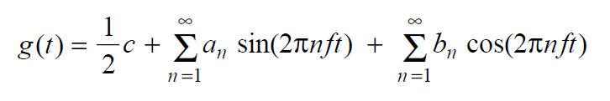
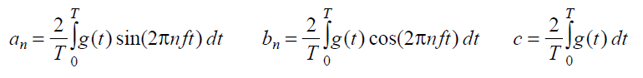
Fourier Analysis
We model the behavior of variation of voltage or current with mathematical functions
Fourier series is used
Function reconstructed with

Slide 4
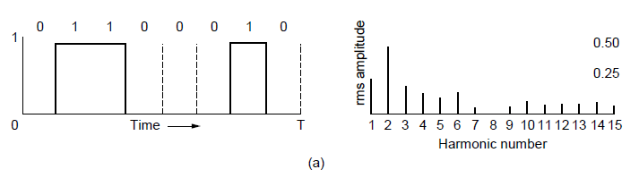
Bandwidth-Limited Signals (1)
A binary signal and its root-mean-square Fourier amplitudes.

Slide 5
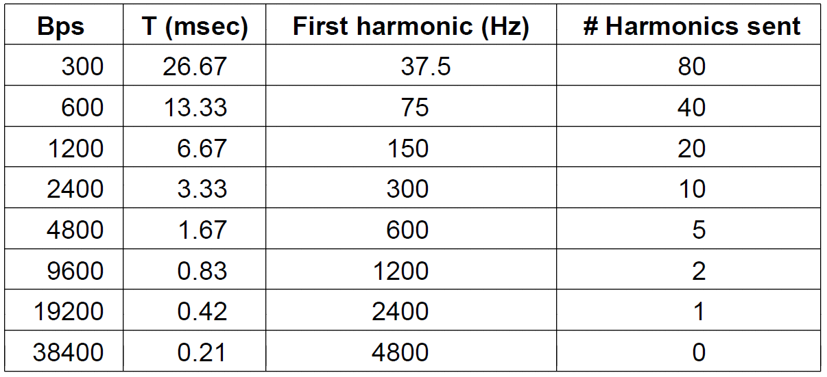
Bandwidth-Limited Signals (6)
Relation between data rate and harmonics for our example.

Slide 6
The Maximum Data Rate of a Channel
Nyquist’s theorem: B bandwidth, V discrete levels
Maximum data rate = 2 B log2V bits/sec
Shannon’s formula for capacity of a noisy channel
S/N signal-to-noise ratio

Slide 7
EXAMPLES
Nyquist’s theorem:比特率=波特率* log2V
Q1：对于带宽为4000HZ的低通信道，采用16种不同的物理状态来表示数据，按Nyquist定理，信道的最大传输速率是多少？
Q2: 电话系统的信道带宽3000HZ,信噪比30dB,该系统的最大数据传输率为多少？

Slide 8
Guided Transmission Media
Magnetic media
Twisted pairs
Coaxial cable
Power lines
Fiber optics

Slide 9
Magnetic Media
Write data onto magnetic media
Disks
Tapes
Data transmission speed
Never underestimate the bandwidth of a station wagon full of tapes hurtling down the highway.

Slide 10
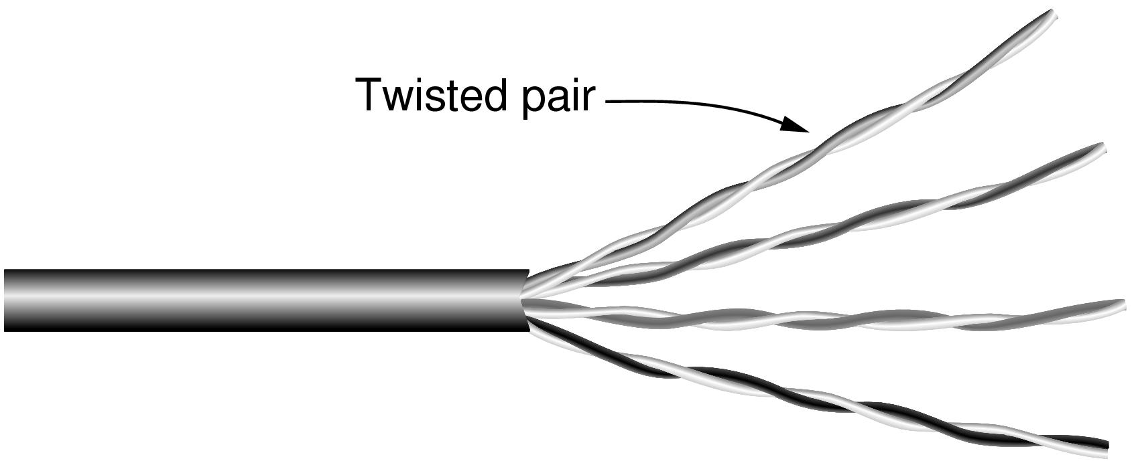
Twisted Pairs
Category 5 UTP cable with four twisted pairs

Slide 11
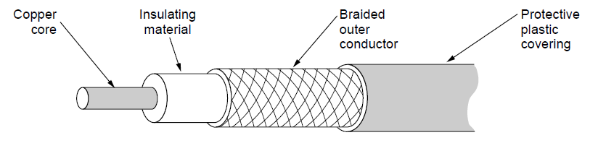
Coaxial Cable
A coaxial cable

Slide 12
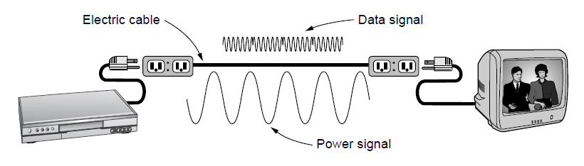
Power Lines
A network that uses household electrical wiring.

Slide 13
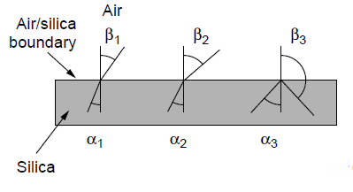
Fiber Optics (1)
Three examples of a light ray from inside a silica fiber impinging on the air/silica boundary at different angles.

Slide 14
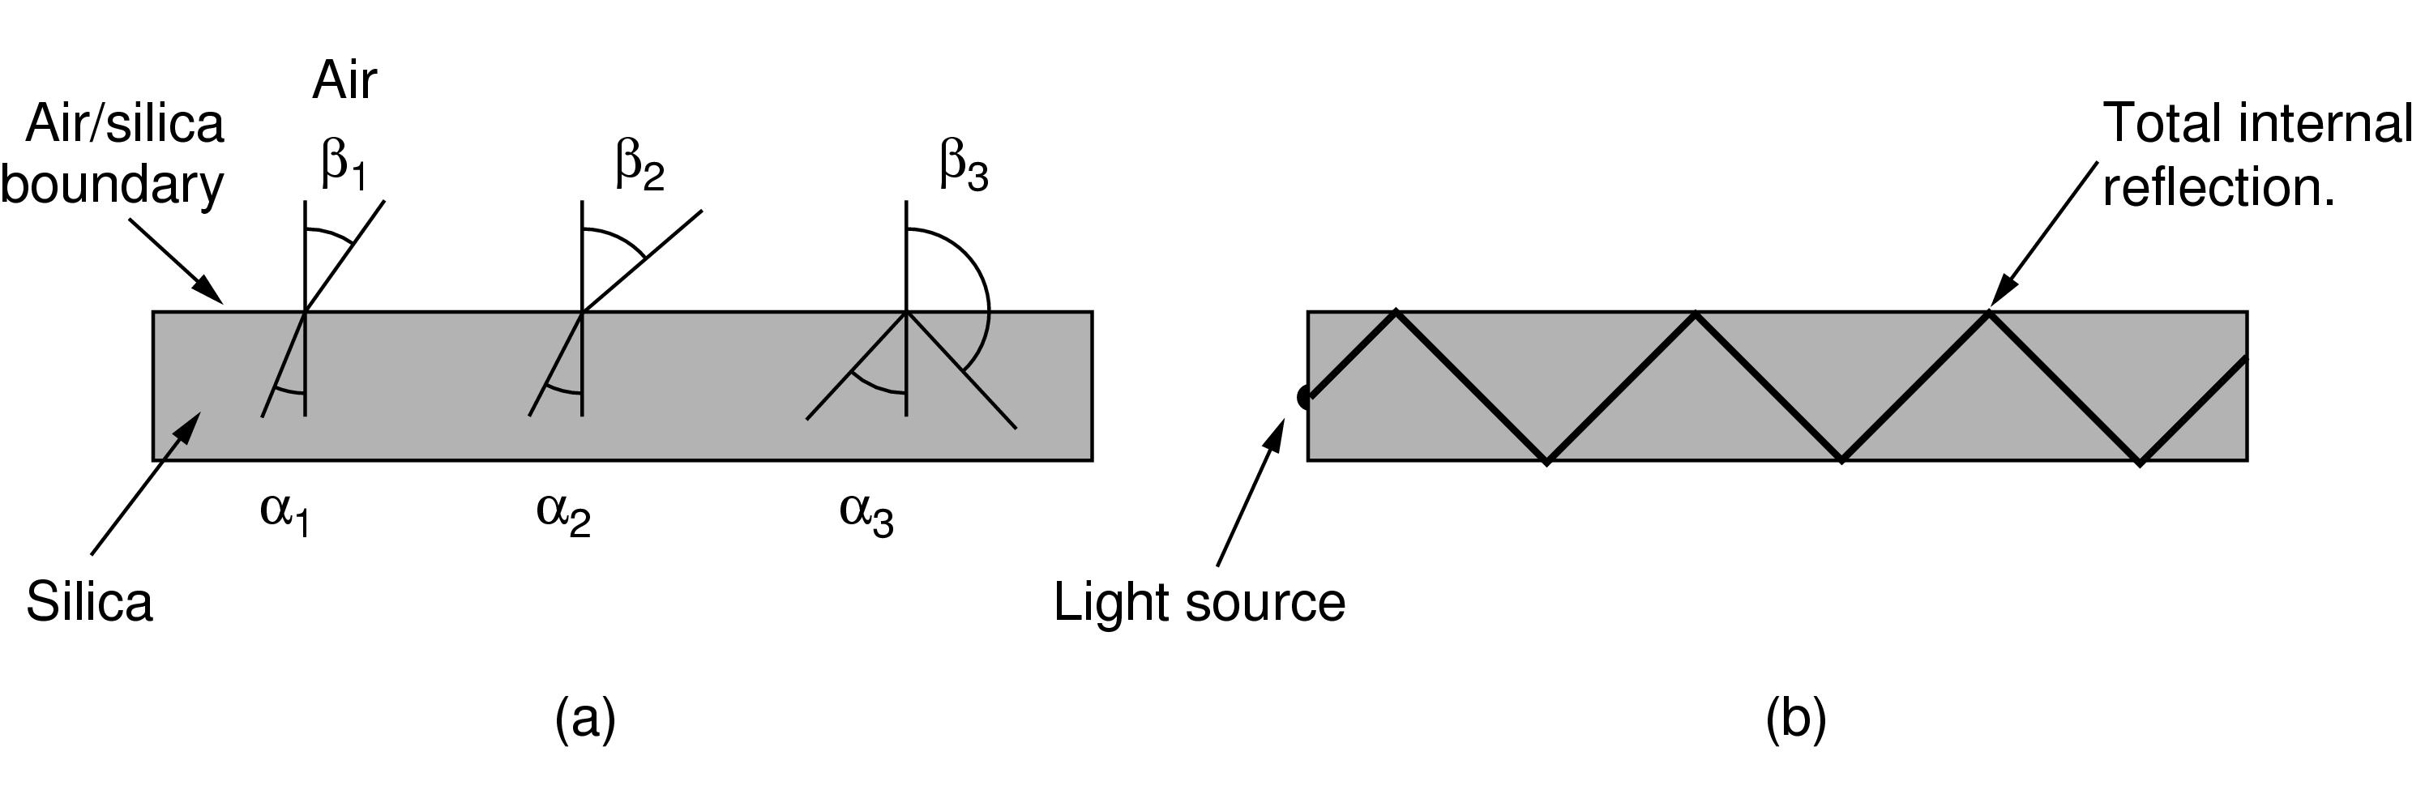
Fiber Optics (2)
Light trapped by total internal reflection.

Slide 15
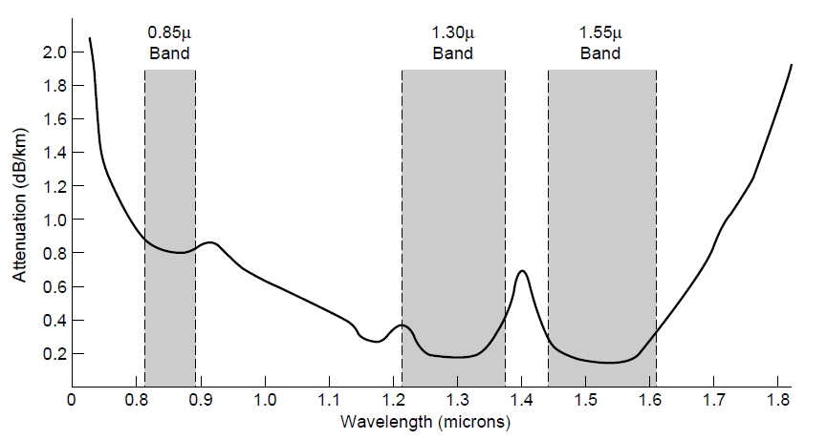
Transmission of Light Through Fiber
Attenuation of light through fiber in the infrared region

Slide 16
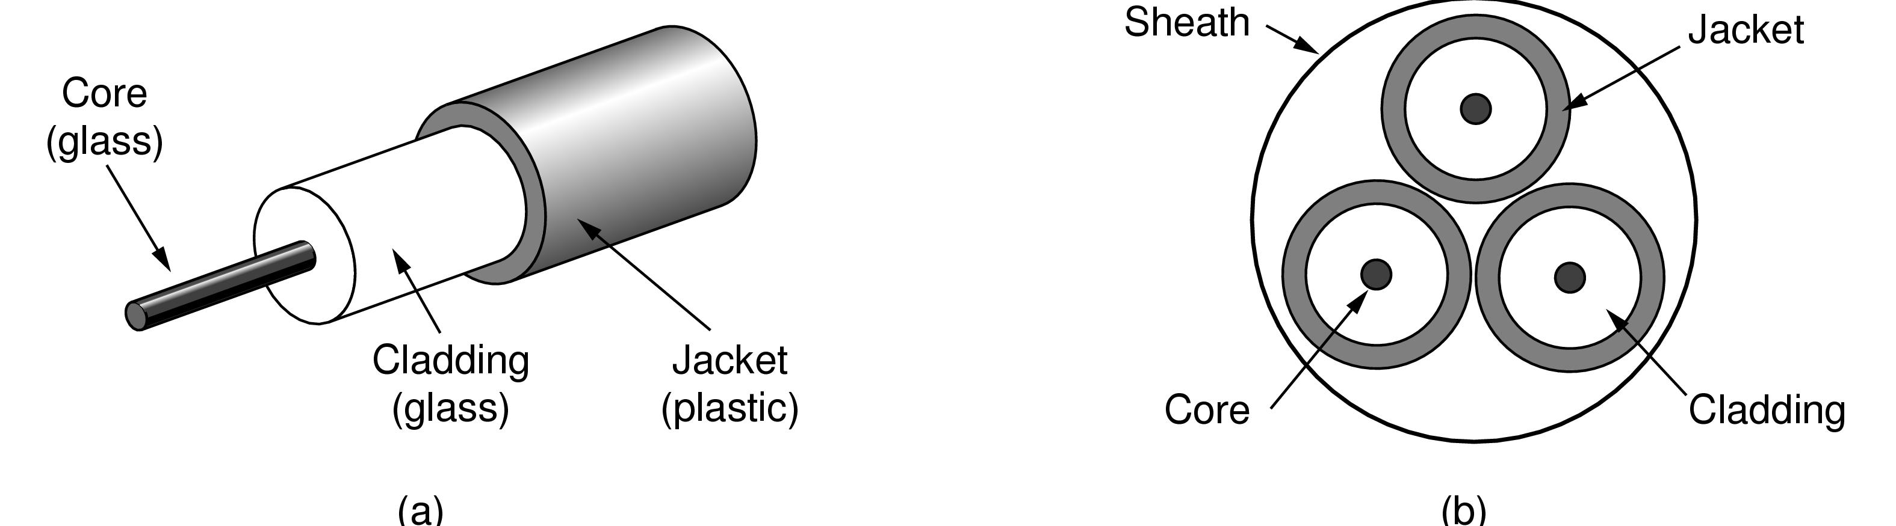
Fiber Cables (1)
Views of a fiber cable

Slide 17
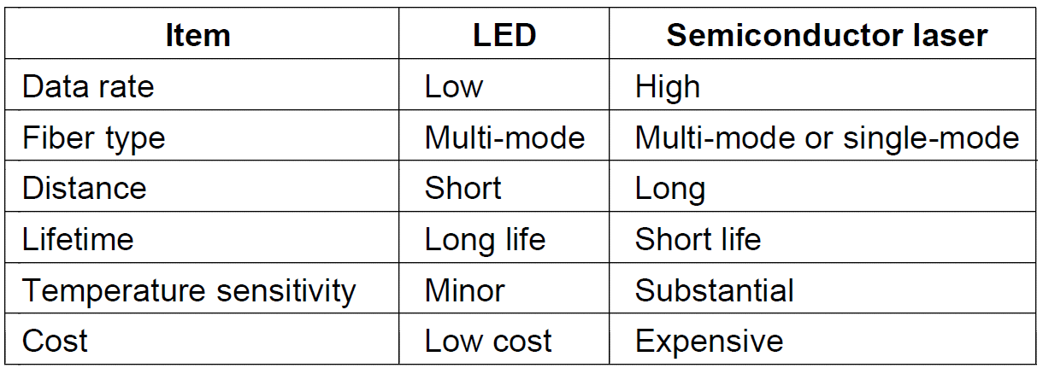
Fiber Cables (2)
A comparison of semiconductor diodes and LEDs as light sources

Slide 18
Wireless Transmission
The Electromagnetic Spectrum
Radio Transmission
Microwave Transmission
Infrared Transmission
Light Transmission

Slide 19
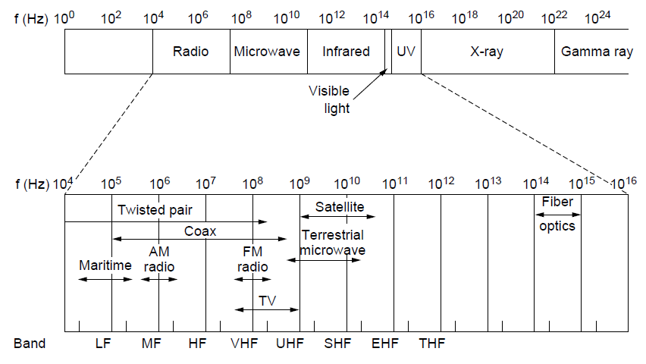
The Electromagnetic Spectrum (1)
The electromagnetic spectrum and its uses for communication

Slide 20
Radio Transmission (1)
In the VLF, LF, and MF bands, radio waves follow the curvature of the earth

Slide 21
Radio Transmission (2)
In the HF band, they bounce off the ionosphere.

Slide 22
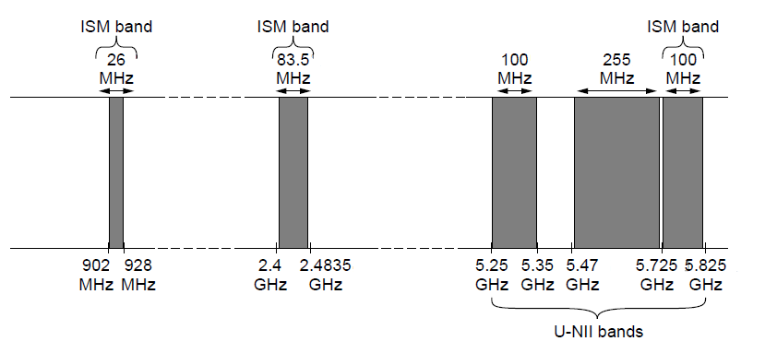
The Politics of the Electromagnetic Spectrum
ISM and U-NII bands used in the United States by wireless devices

Slide 23

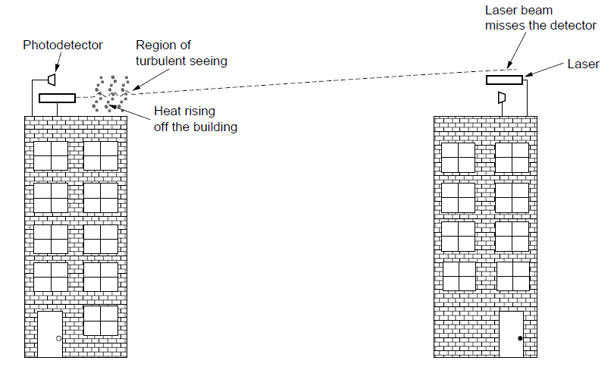
Light Transmission
Convection currents can interfere with laser communication systems. A bidirectional system with two lasers is pictured here.

Slide 24
Communication Satellites
Geostationary Satellites
Medium-Earth Orbit Satellites
Low-Earth Orbit Satellites
Satellites Versus Fiber

Slide 25
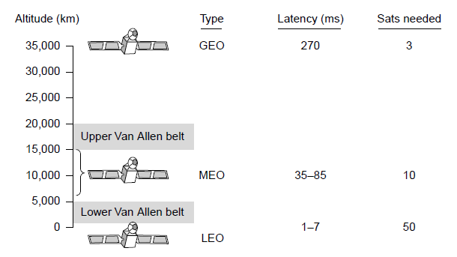
Communication Satellites
Communication satellites, some properties, including: altitude above earth, round-trip delay time, number of satellites for global coverage.

Slide 26
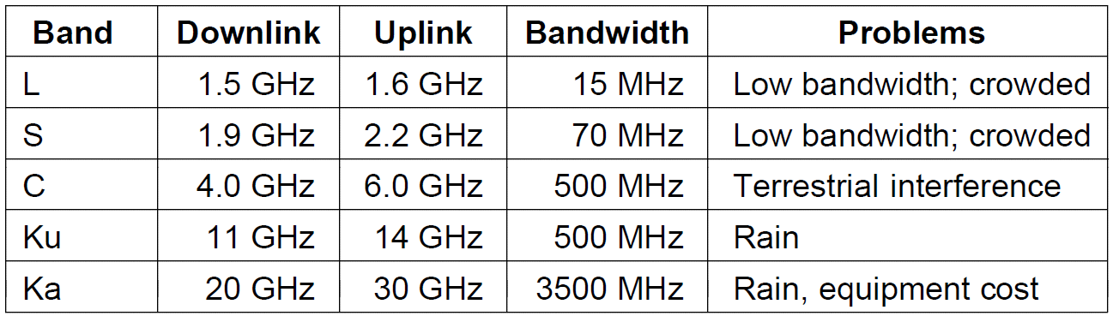
Geostationary Satellites (1)
The principal satellite bands

Slide 27
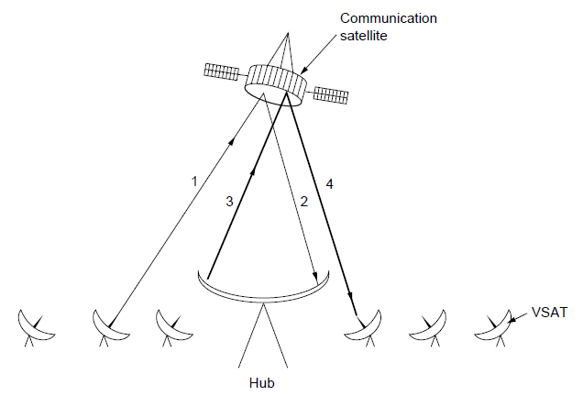
Geostationary Satellites (2)
VSATs using a hub.

Slide 28
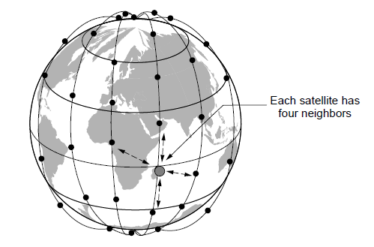
Low-Earth Orbit Satellites (1)
The Iridium satellites form six necklaces around the earth.

Slide 29
Low-Earth Orbit Satellites (2)
Relaying in space.

Slide 30
Low-Earth Orbit Satellites (3)
Relaying on the ground

Slide 31
Digital Modulation and Multiplexing
Baseband Transmission
Passband Transmission
Frequency Division Multiplexing
Time Division Multiplexing
Code Division Multiplexing

Slide 32
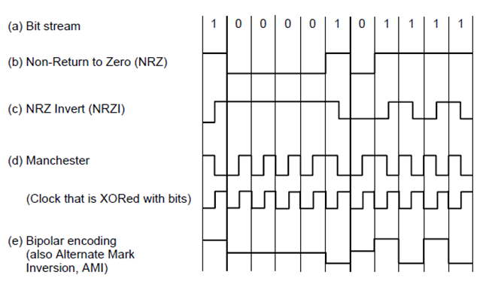
Baseband Transmission
Line codes: (a) Bits, (b) NRZ, (c) NRZI, (d) Manchester, (e) Bipolar or AMI.

Slide 33
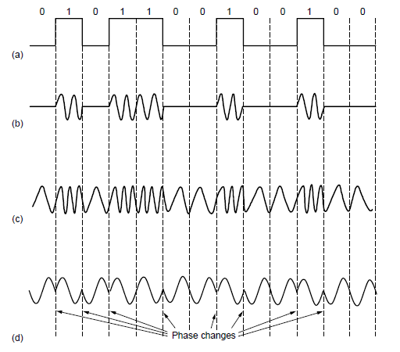
Passband Transmission (1)
(a) A binary signal. (b) Amplitude shift keying. (c) Frequency shift keying. (d) Phase shift keying.

Slide 34
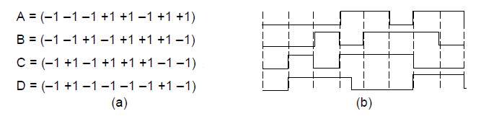
Code Division Multiplexing (1)
Chip sequences for four stations.
Signals the sequences represent

Slide 35
The Public Switched Telephone Network
Structure of the telephone system
Politics of telephones
Local loop: modems, ADSL, and fiber
Trunks and multiplexing
Switching

Slide 36
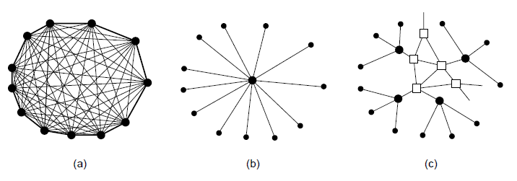
Structure of the Telephone System (1)
Fully interconnected network.
Centralized switch.
Two-level hierarchy.

Slide 37
Structure of the Telephone System (2)
A typical circuit route for a long-distance call.

Slide 38
Structure of the Telephone System (3)
Major Components
Local loops analog twisted pairs to houses, businesses).
Trunks (digital fiber optic links between switching offices).
Switching offices (calls are moved from one trunk to another).

Slide 39
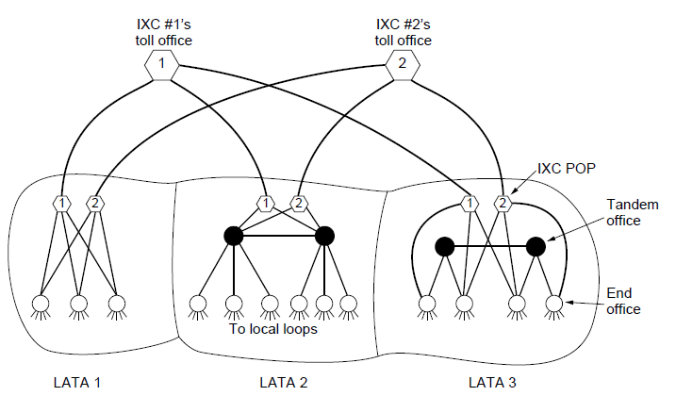
The Politics of Telephones
The relationship of LATAs, LECs, and IXCs. Circles are LEC switching offices. Hexagons belong to IXC whose number is in it.

Slide 40
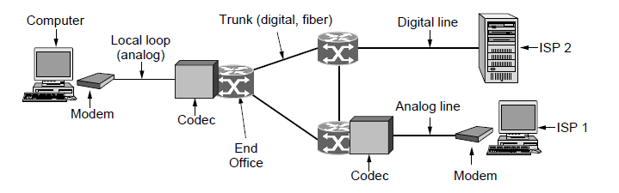
Telephone Modems
Use of both analog and digital transmission for computer -to-computer call. Conversion done by modems and codecs.

Slide 41
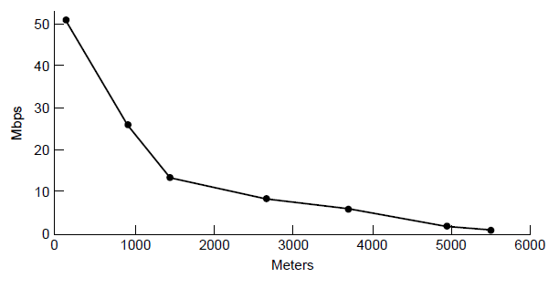
Digital Subscriber Lines (1)
Bandwidth versus distance over Category 3 UTP for DSL.

Slide 42
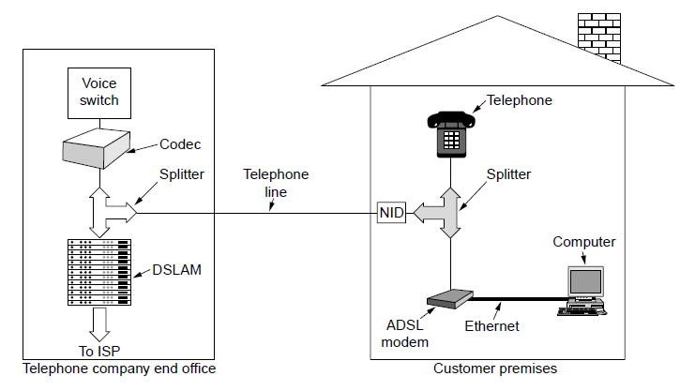
Digital Subscriber Lines (3)
A typical ADSL equipment configuration.

Slide 43
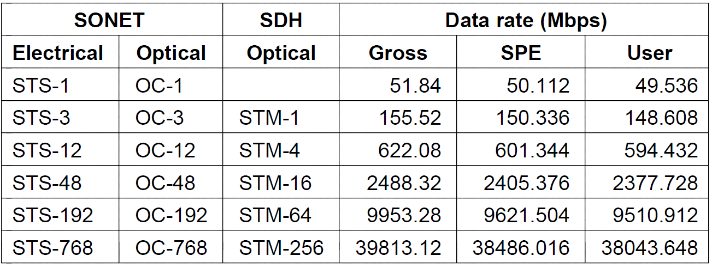
SONET/SDH (2)
SONET and SDH multiplex rates.

Slide 44
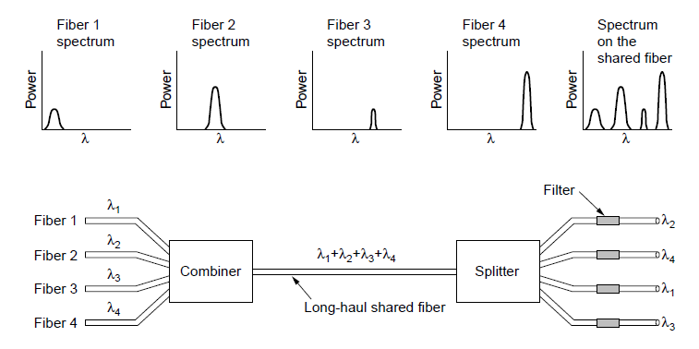
Wavelength Division Multiplexing
Wavelength division multiplexing

Slide 45
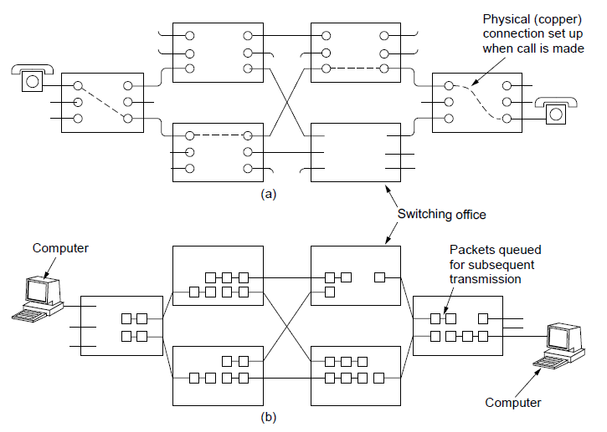
Circuit Switching/Packet Switching (1)
(a) Circuit switching. (b) Packet switching.

Slide 46
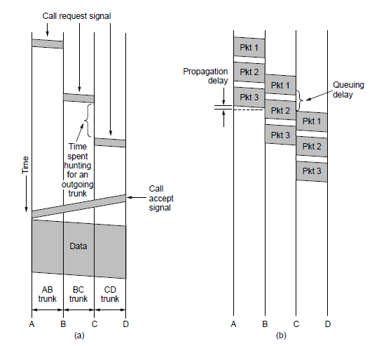
Circuit Switching/Packet Switching (2)
Timing of events in (a) circuit switching, (b) packet switching

Slide 47
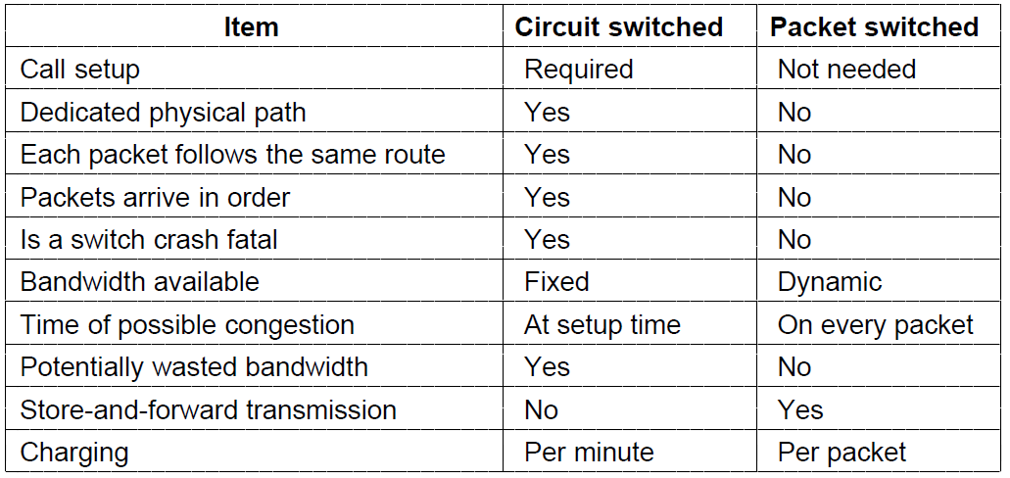
Circuit Switching/Packet Switching (3)
A comparison of circuit-switched and packet-switched networks.

Slide 48
Mobile Telephone System
First-Generation (1G) Mobile Phones Analog Voice
Second-Generation (2G) Mobile Phones Digital Voice
Third-Generation (3G) Mobile Phones Digital Voice + Data

Slide 49
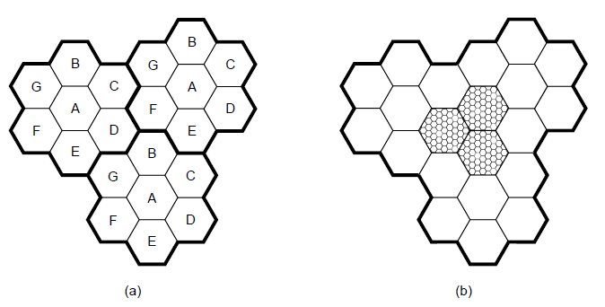
Advanced Mobile Phone System
(a) Frequencies are not reused in adjacent cells. (b) To add more users, smaller cells can be used.

Slide 50
GSM—The Global System for Mobile Communications (1)
GSM mobile network architecture.

Slide 51
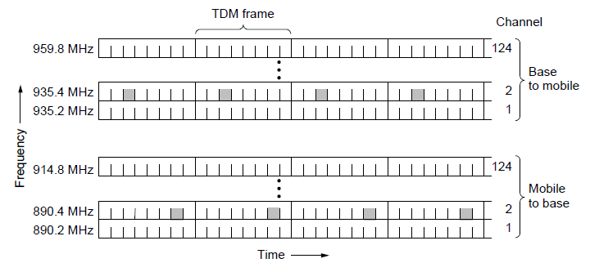
GSM—The Global System for Mobile Communications (2)
GSM uses 124 frequency channels, each of which uses an eight-slot TDM system.

Slide 52
Cable Television
Community antenna television
Internet over cable
Spectrum allocation
Cable modems
ADSL versus cable

Slide 53
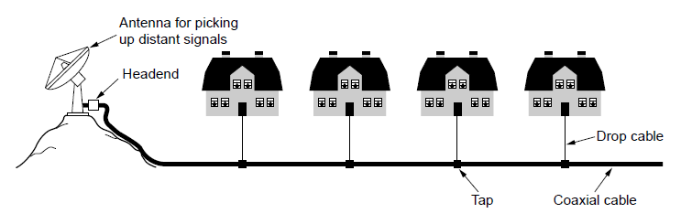
Community Antenna Television
An early cable television system

Slide 54
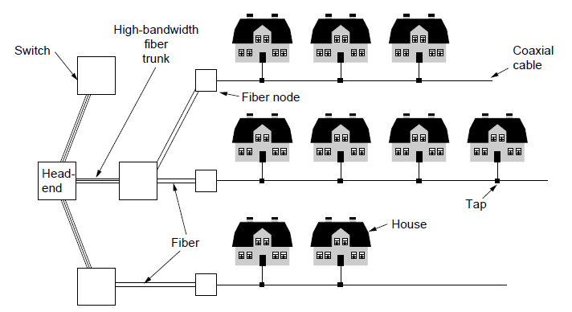
Internet over Cable (1)
Cable television

Slide 55
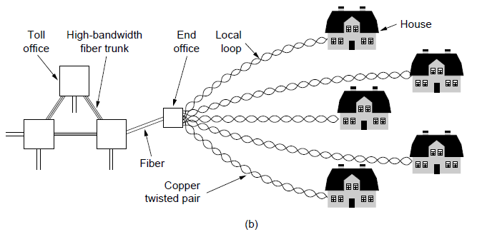
Internet over Cable (2)
The fixed telephone system.

Slide 56
End
Chapter 2

